Slide 1
Your health fighting stress, staying healthy
Basic 08
Unit 8ª

Slide 2
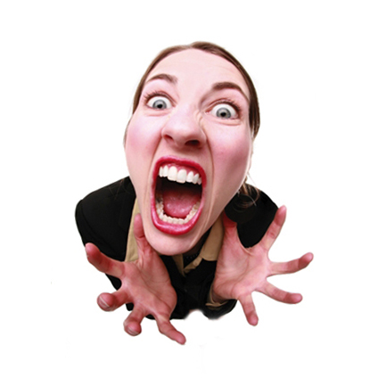
She is stressed
What’s wrong with her?

Slide 3
Terrible

Slide 4
Tired

Slide 5
Exhausted (Very tired)

Slide 6
Down ☹

Slide 7
Stressed

